Slide 1
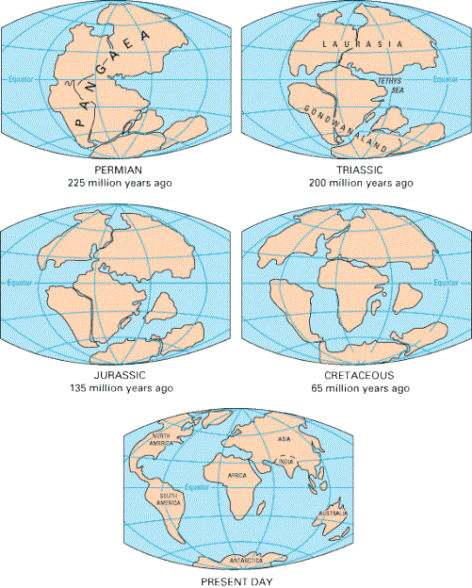
The Theory of Continental Drift

Slide 2
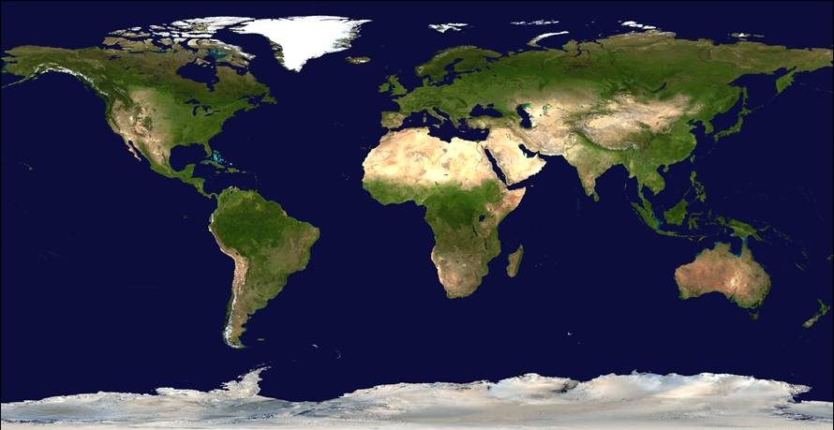
The World

Slide 3
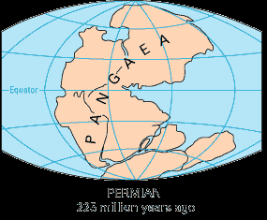
ALFRED WEGENER THEORY OF CONTINENTAL DRIFT
Found evidence for PANGAEA and proposed the theory of continental drift.

Slide 4
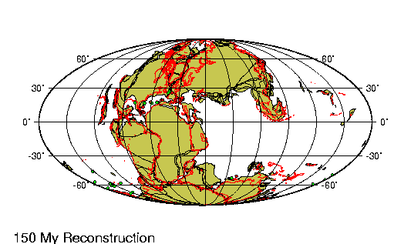
Continental Drift Theory
Theory that continents were once part of a single landmass 200 million years ago that broke apart and have moved to their present locations.
can drift apart from one another and have done so in the past
Theory was not accepted by scientists because he had no force (mechanism) that pushes and pulls the continents

Slide 5
Pangaea
Pangaea is the name given to the single landmass that was present 200 million years ago

Slide 6
Wegener’s 6 Evidences
1) Fit of the Continents
2) Fossils
3) Mountains
4) Glaciers
5) Rock Types and Ages
6) Climate

Slide 7
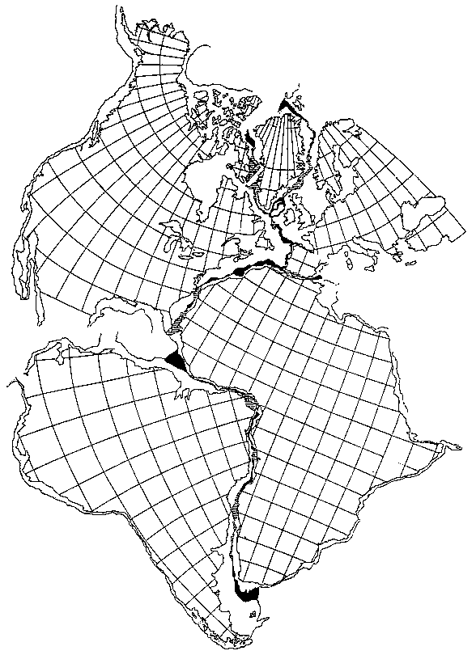
EVIDENCE #1 FIT OF CONTINENTS
Continents
“fit together”
like puzzle
pieces

Slide 8
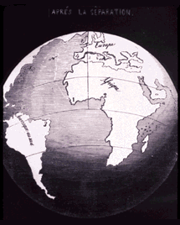
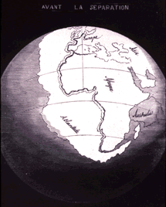
EVIDENCE #1 FIT OF CONTINENTS
The Fit between Africa and South America

Slide 9
EVIDENCE #2 FOSSILS
Fossil Evidence
fossils are remains of living things that lived long ago.
similar fossils have been discovered in matching coastlines on different continents.

Slide 10
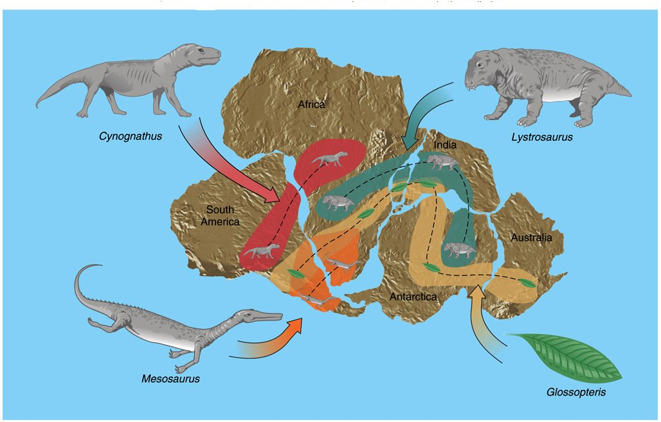
EVIDENCE #2 FOSSILS

Slide 11
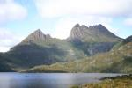
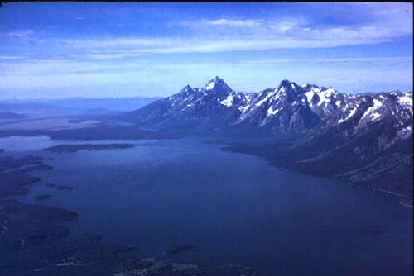
EVIDENCE #3 MOUNTAINS
Mountains
Some mountain ranges on different continents seem to match.
Ex: ranges in Canada match Norway and Sweden
Ex: Appalachian Mtn. match UK mtn

Slide 12
EVIDENCE #3 MOUNTAINS

Slide 13
EVIDENCE #3 MOUNTAINS

Slide 14
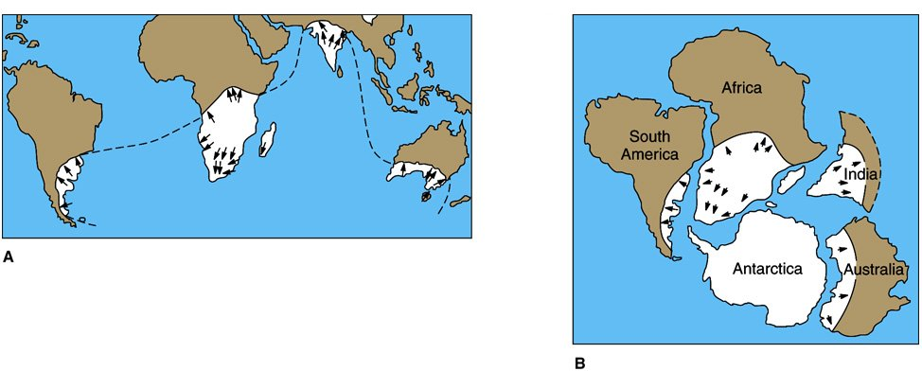
EVIDENCE #4 GLACIERS
Glaciers in areas that are now close to the Equator

Slide 15
EVIDENCE #4 GLACIERS
Grooves carved by glaciers were found on many continents.

Slide 16
EVIDENCE #4 GLACIERS

Slide 17
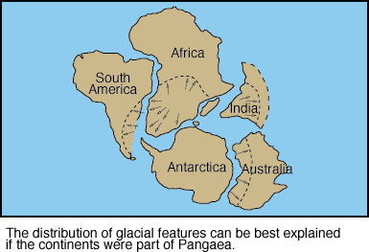
EVIDENCE #4 GLACIERS

Slide 18
EVIDENCE #5 ROCK AGE AND TYPE

Slide 19
EVIDENCE #6 CLIMATE
Wegener looked at certain areas on the Earth and their climates
Noted that the fossils he found on certain sections of Earth did not match the current climate.
Fossils of tropical plants in the form of coal deposits in Antarctica
Glacier deposits in present day desert like areas in Africa

Slide 20
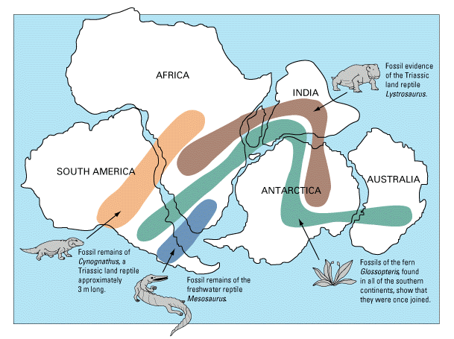
EVIDENCE #6 CLIMATE
Such as: Coal deposits in Antarctica

Slide 21
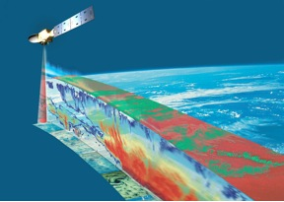
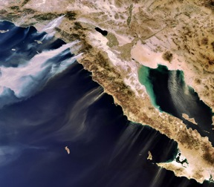
Satellites used to measure the movement of continents
Evidence of Continental Drift
Laser Geodynamics
Satellite (LAGEOS)

Slide 22
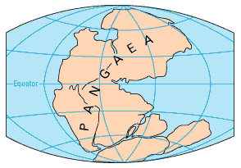
All this evidence points to a Supercontinent.

Slide 23
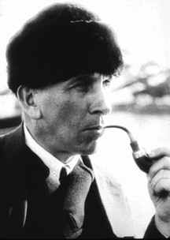
The Theory of Continental Drift had a fatal weakness.
Wegener couldn't answer the fundamental question:
What kind of forces could be strong enough to move such large masses of solid rock over such great distances?

Slide 24
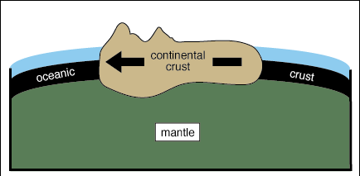
He said: The continents simply plowed through the ocean floor !!!

Slide 25
Wegener's theory was dismissed as being eccentric, preposterous, and improbable …
Wegener died
in 1930 never
knowing that
his theory was
finally accepted
by most scientists.
Technology developed during the 1940’s changed all that!

Slide 26
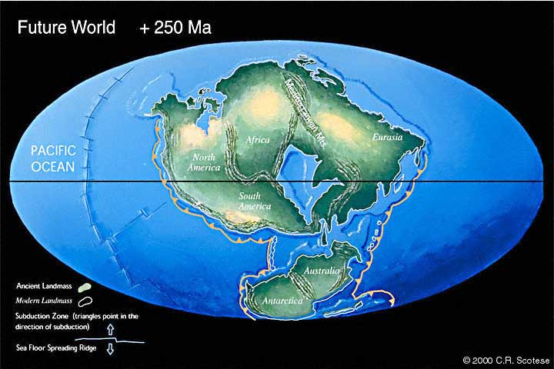
The Plates Move… So what now?
Which way?
50 million years

Slide 27
Try these links below:
http://www.geo.cornell.edu/hawaii/220/PRI/PRI_PT_contdrift.html
http://www.glencoe.com/sites/common_assets/science/virtual_labs/ES11/ES11.html

